Slide 1
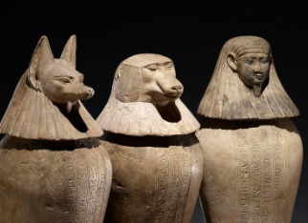
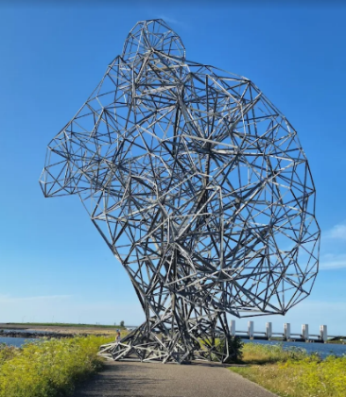
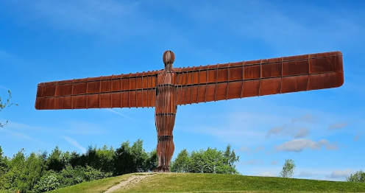
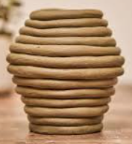
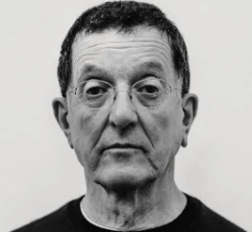
Year 3 Spring 2 – Sculpture.
Key Vocabulary
Sculpt | To create something using shaping techniques
Sculptor | An artist who creates sculptures.
Material | What something is made from
Design | A plan of what is going to be made
Media | The materials used by an artist
Texture | How something feels or appears
Join | To fix materials together
Surrealisms | When something isn’t a true representation of reality.
Key Questions.
What is surrealism?
What material is best for a sculpture?
How have sculptures been used throughout history?
What techniques am I going to use to create my sculpture?
How does my sculpture look?
Antony Gormley 1950 - present

