Slide 1
Active Wear
Parent/Carer Meeting
9th June 2026

Slide 2
agenda
Rationale
Class of 2035
Proposed uniform
Expectations
Identity
Financial
Impact

Slide 3
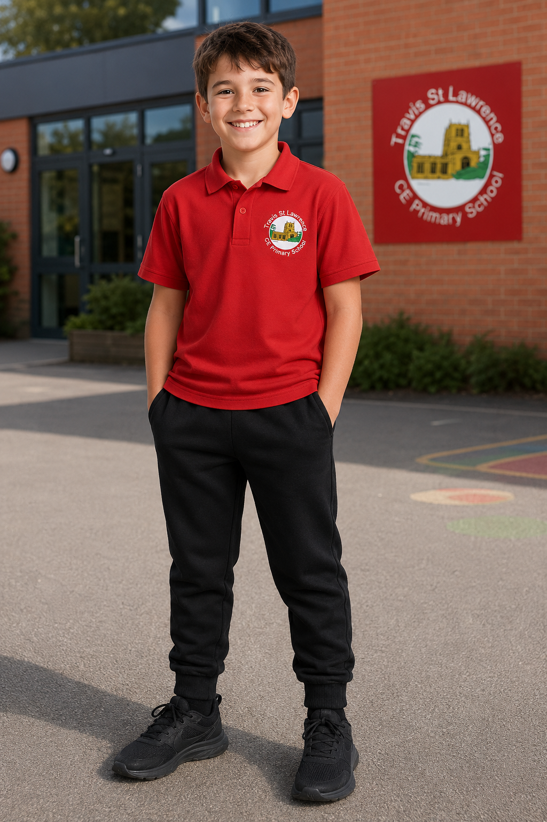
Rationale
- Adopt Opal Strategy
- Children more active
- Children taking more ‘risks’
- children more comfortable
- improved consistency
- Class of 2035 https://www.youthsporttrust.org/research-listings/research/class-of-2035

Slide 4
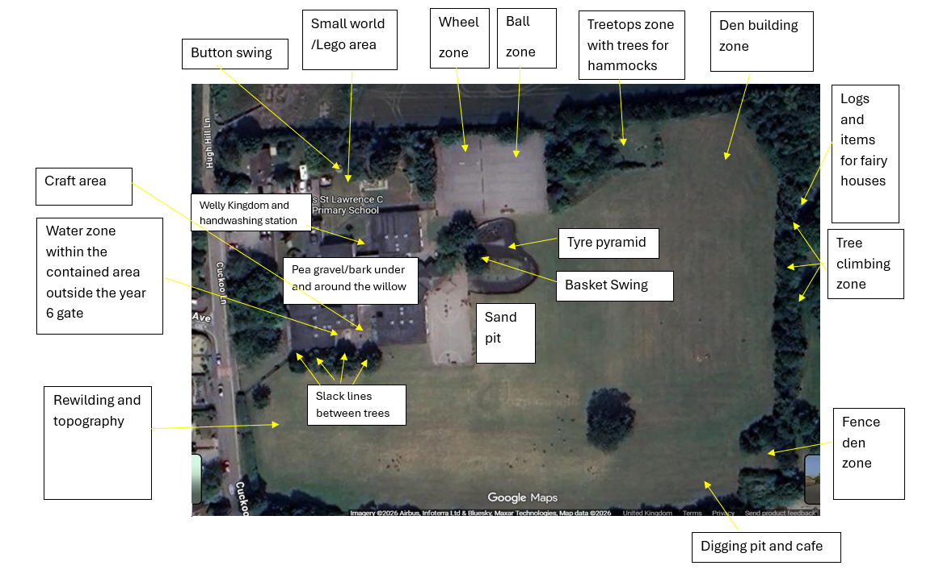
Proposed Opal upper
plan

Slide 5
Class of 2035
By 2035, if current trends continue:
Almost half (48%) of children will spend three hours or more on screens for entertainment each day, up from 34% in 2025.
More than a third (34%) will fail to be active for even 30 minutes a day, well short of the UK’s Chief Medical Officers’ guidance of 60 active minutes.
Annual Type 2 diabetes diagnoses in children will double, reaching 500 new cases each year.
Obesity and mental health disorders are projected to increase significantly, with more than 180,000 children (24%) classified as clinically obese by 2035.
Schools will see declining attendance, engagement, and belonging among the least active pupils.

Slide 6
Video
https://www.youtube.com/watch?v=DzKVHQY6lsQ Active Uniform video for parents/carers

Slide 7
Proposed Uniform
Red polo t-shirt (school logo but not essential)
Red cardigan/jumper (school logo but not essential)
Black jogging bottoms/legging/shorts/skort (no designer logos on them just plain black)
Black trainers (no designer logos on them just plain black)
Wellington boots (children will be out and on the grass in nearly all weathers)
Coat
Water Bottle
Book bag

Slide 8
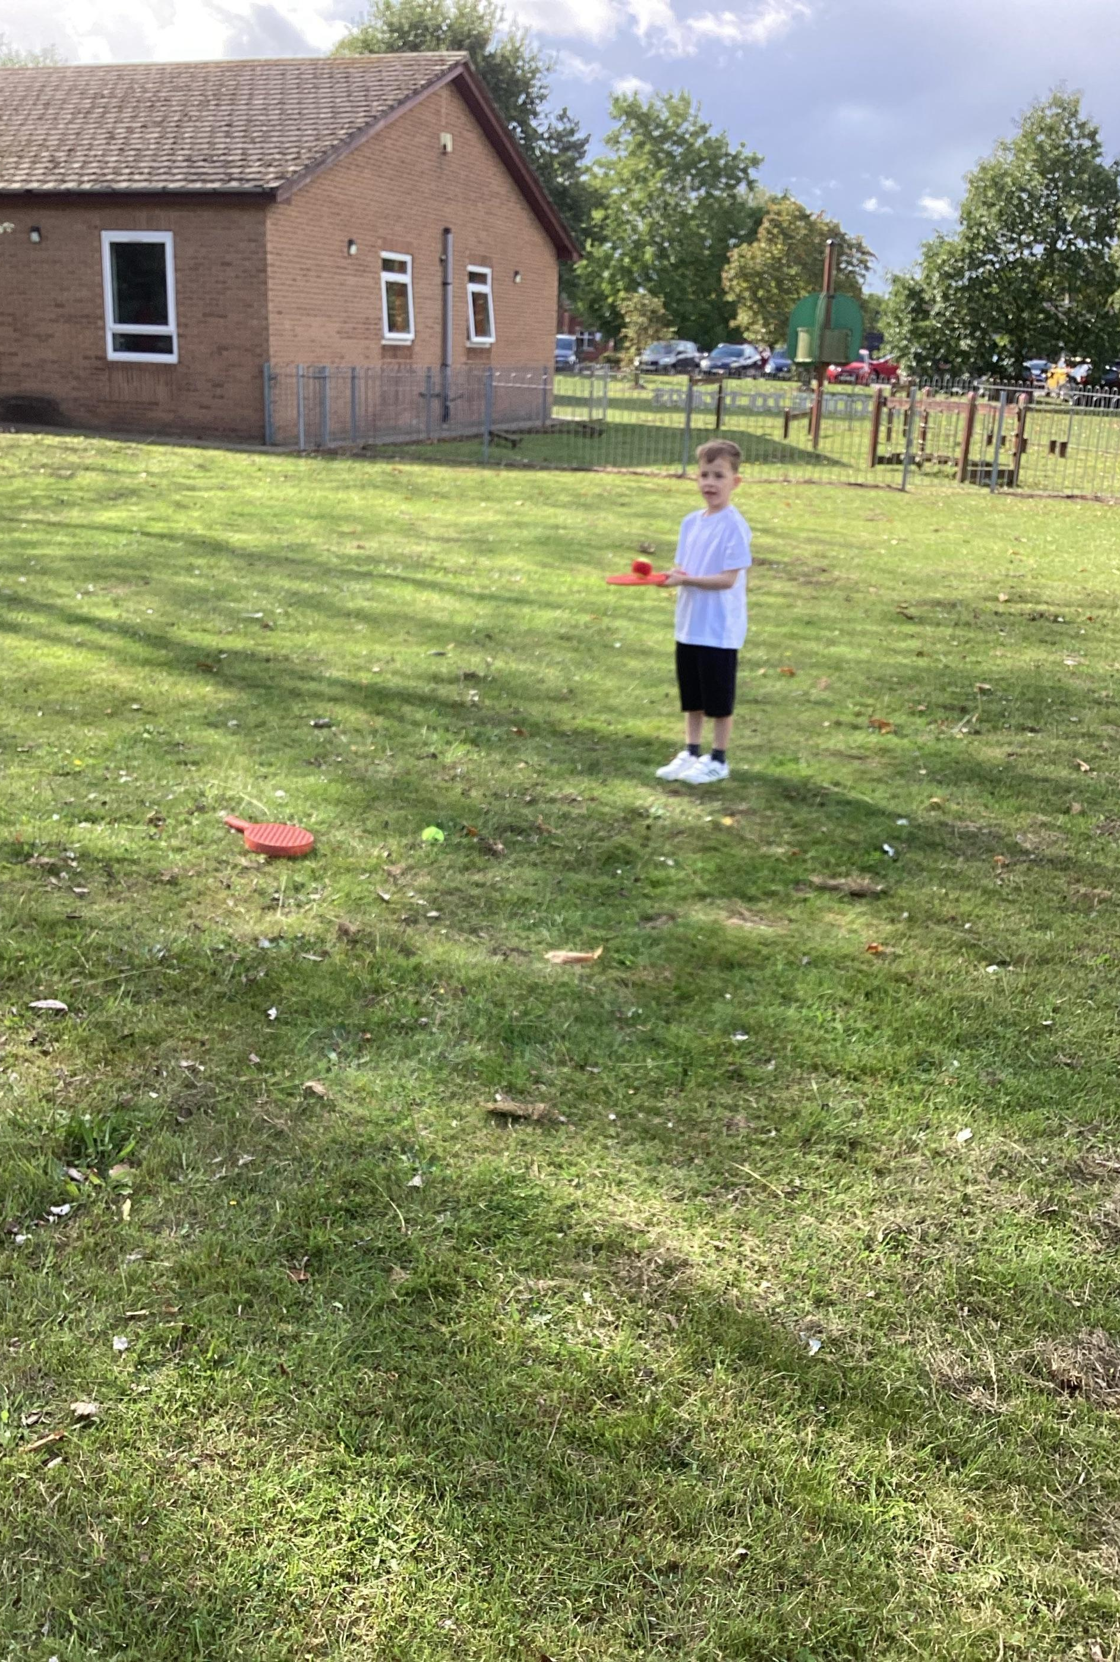
Expectations
Maintain high expectations
No compromise on behaviour expectations

Slide 9
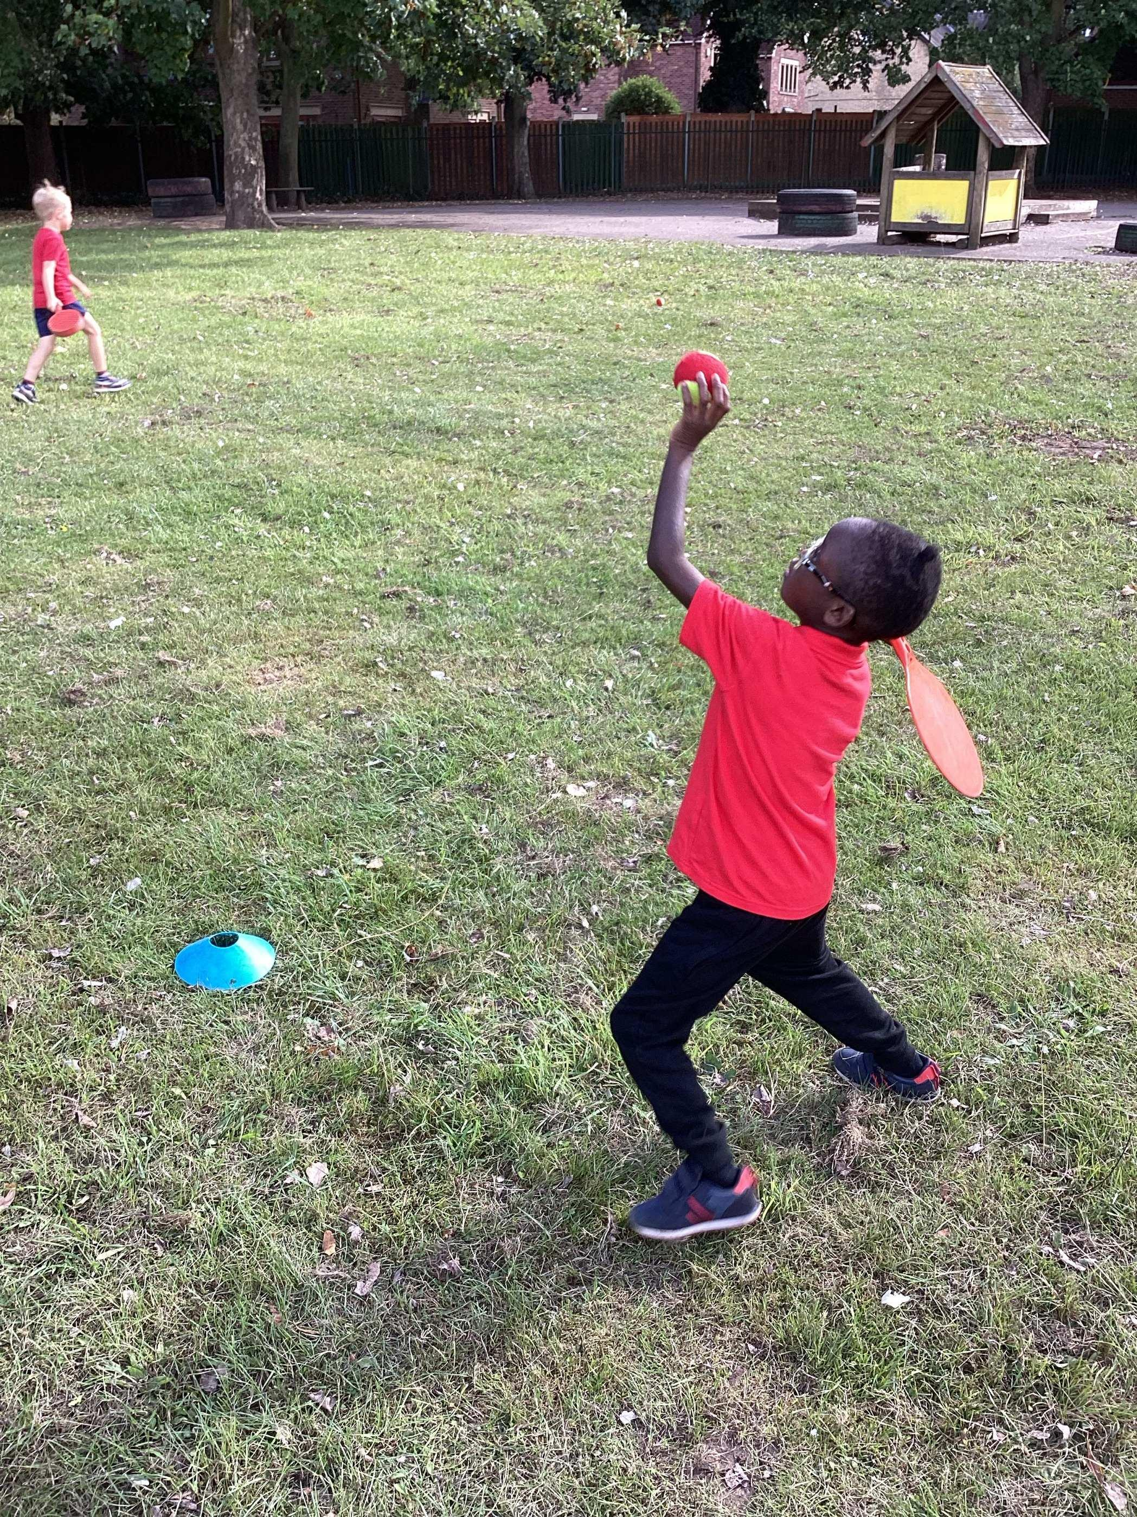
identity
All children will have the same uniform
so a strong sense of identity will continue

Slide 10
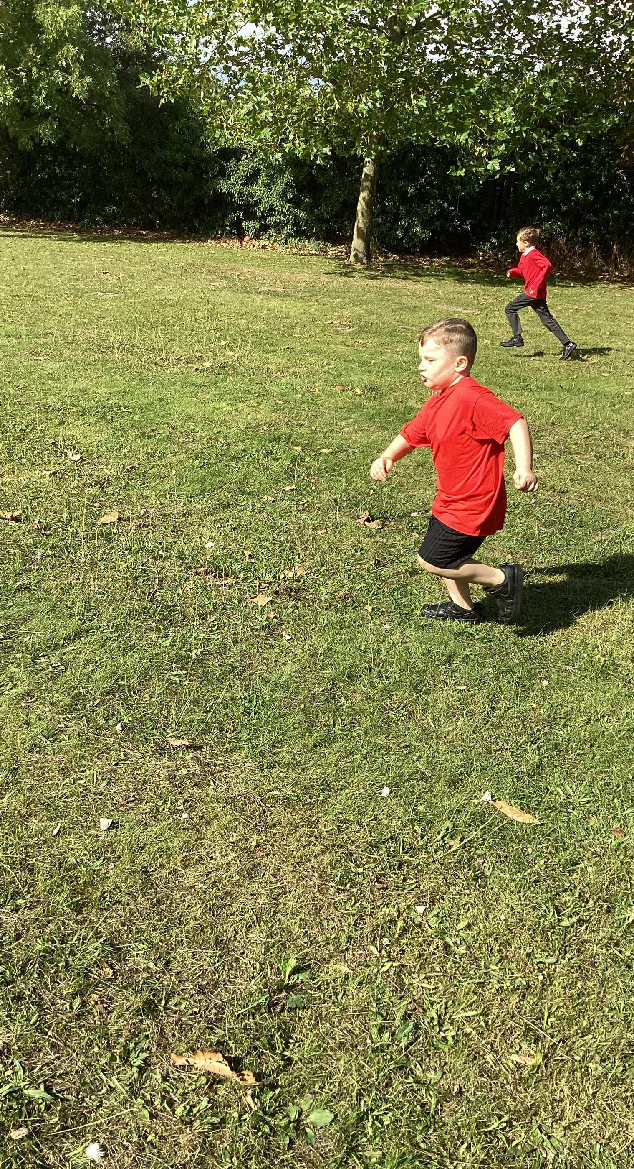
Financial
No additional uniform to purchase
As no logo then cheap items which would not impact if get dirty
Wellingtons where children

Slide 11
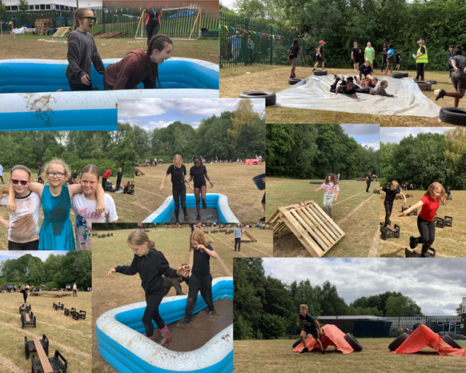
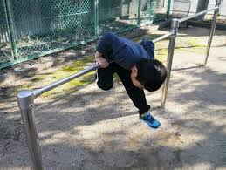
Safeguarding
Lots more activities so children will be physically active
When spinning and twirling on items then don’t want children in skirts.

Slide 12
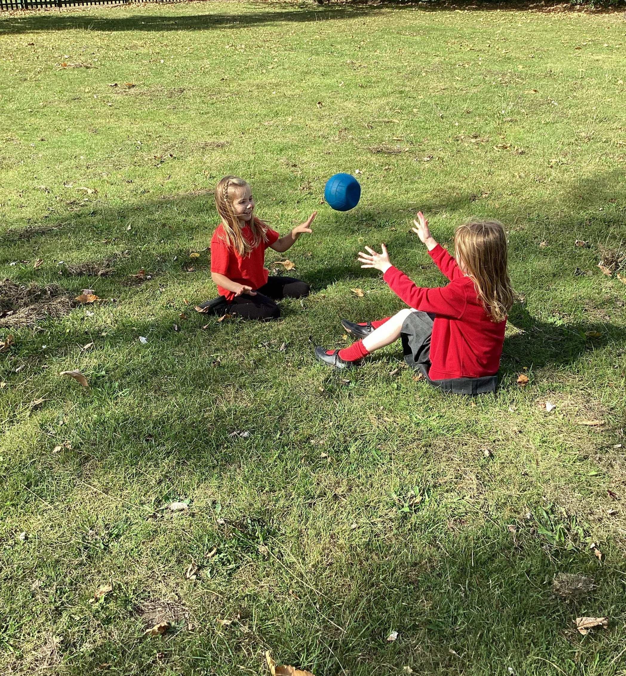
Speaking impact
https://activeuniform.org/case-study-grimes-dyke-primary-school-leeds/ case study
“The children and staff are far happier!”
“The curriculum is much more flexible allowing teachers to plan active lessons as well as in the moment activities without worrying about children in skirts and school shoes.”
“Children grow up far too quickly in a world with external online pressures and once they move on to high school we have lost them to mini adults – they are 11! If you only get 10 years of your life to be a child then it’s my job to protect that right and not to prepare them for high school. ”
“In order to thrive as a child you need to be able to play and to do this freely, without limitations, you need to be dressed to move. We would never go back to a formal uniform; it would limit us in what we are trying to achieve. ”

Slide 13
Thank you

