Slide 1
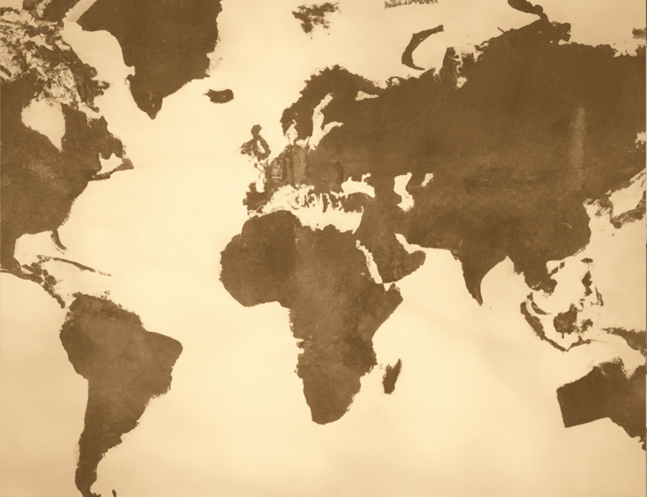




Ancient Egypt - timeline
Why this period is important
You are learning about ancient Egypt, because it is the best known and most popular of the early civilisations that grew up over 5,000 years ago. This was the time when people changed from being hunter gathers to living in large, organised settlements. In the case of Egypt the people were brought together under one king, the pharaoh, and were capable of building pyramids and temples which still stand today, close to the all-important river Nile.
We know so much about the daily lives of the ancient Egyptians - we can read their words, meet their families, feel their clothes, taste their food and drink, enter their tombs and even touch their bodies - that it seems that we almost know them. Ancient Egypt is definitely one of the earliest civilisations to have left written, pictorial and archaeological records of its culture, including medicine, mathematics, and astronomy that allows us to know so much of a civilisation that existed 5,000 years ago.
Egypt
A comparative timeline of the first civilisations
3,000 BC
2,500 BC
2,000 BC
3,200 BC
Sumer (Mesopotamia)
1,792 BC
2,600 BC
Indus
1,900 BC
3,150 BC
Egypt
2,700 BC
China

Slide 2
Key vocabulary
Top takeaways
1. That Ancient Egypt is just one of 5 major ancient civilisations which emerged about 5000 years ago, each being organised with cities and having their own form of communication- e.g. hieroglyphics or cuneiform.
2. Egypt was ruled by Pharaohs who were seen more like a god than just a person. Tutankhamun is the most famous whose tomb was only discovered 100 years ago Below the pharaoh there were other levels of society from viziers and scribes and priests down to slaves.
3. The Egyptians worshipped hundreds of gods, many represented by animals.
4. Much of daily life in Egypt was influenced by the Nile which flooded every year, essential for growing crops.
5. We know that the Egyptians thought that people who died went to a new world and we have lots of artefacts used in the mummification process.
6. Much of what we know for sure about Ancient Egypt comes from the Rosetta stone discovered only 200 years ago. There are still a lot of unanswered questions about this ancient civilization such as did slaves really build the pyramids?
KQ6
What did Ancient Egypt have in common with other
civilisations at
the time?
KQ1
So you think you know about Ancient Egypt?
Ancient | The term to describe history before 500AD
Artefact | An object made by human beings
Ankh | Symbol of life which only gods and kings carried
Civilisation | Way of life of a group of people
Embalming | Preserving the dead body using chemicals salts and oils
Excavate | To dig in the ground to discover old buildings or objects that have been buried for a long time
Flax | Plant that can be made into cloth
Hieroglyphics | Symbols used by Ancient Egyptians in their writing
Mummification | A way of preserving a body after death
Natron salt | Absorbs water used to dry the body before it was wrapped in bandages
Papyrus | Paper made from the stems of the papyrus plant
Pharaoh | A ruler of Ancient Egypt who was very wealthy who the people thought came from the sun-god Ra
Pyramid | Stone structure that has a square base and sloping triangular sides that join at the top built to house dead bodies of their kings who were like gods living on earth
Sarcophagus | Massive stone, painted outer coffin in which mummy was stored
KQ5
Embalming the dead in Ancient Egypt
KQ2
How can we discover what Ancient Egypt was like over 5,000 years ago?
KQ4
What can an old clay model tell us about life in Ancient Egypt 5,000 years ago?
KQ3
So who did build the pyramids?
Scribe | Person whose job it was to read, write and keep records
Rosetta Stone | A broken part of a bigger stone slab. It was an important clue that helped researchers read hieroglyphics
Sphinx | Sculpture with lion’s body and head of the ruler built to guard the pharaoh in the afterlife
Tomb | Grave or building where body of dead person is laid
Vizier | Important men who worked for the pharaoh

