Slide 1

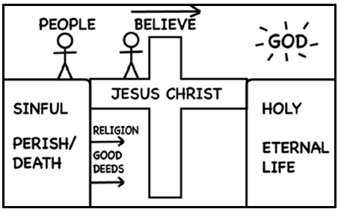
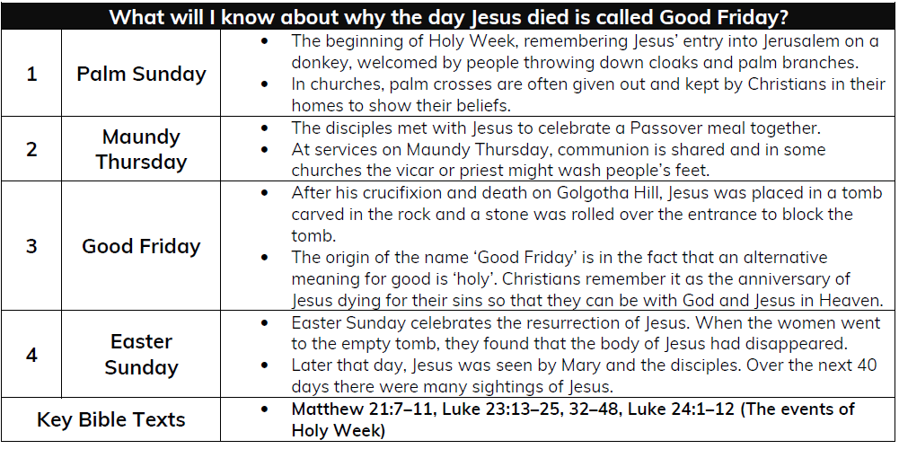
Year 3 Spring 2 - Why do Christians call the day Jesus died ‘Good Friday’?
Key Vocabulary | Definition.
Cross | Vertical and horizontal bars. Represents the cross Jesus died on.
Crucifixion | Referring to the death of Jesus on a cross. A Roman punishment.
Easter Sunday | The most important day for Christians when Jesus rose from the dead.
Good Friday | The day that Jesus died/ The day he was tried by Pontius Pilate and crucified on Golgotho Hill.
Holy Week | The last week of Jesus’ earthly life, starting on Palm Sunday.
Hope | A feeling of expectation and a desire for something to happen.
Incarnation | The birth of Jesus – God the son in the human flesh.
Maundy Thursday | The day before Good Friday, the day of the last supper.
Palm Sunday | Commemorates Jesus’ entry into Jerusalem and is the start of Holy Week
Resurrection | Christians believe Jesus rose form the dead and became ‘Christ’ the risen one, the Messiah
Sacrifice | The act of giving something up for something more important
Salvation | The act of saving or being saved.
Sticky Knowledge:
Easter is very important in the ‘big story’ of the Bible. Jesus showed that he was willing to forgive all people, even putting himself on the cross.
Christians believe Jesus builds a bridge between God and humans.
Christians believe Jesus rose from the dead, giving people hope of a new life.

