Slide 1

RSHE Updates
Changes from September 2026
Travis St Lawrence CE Primary School

Slide 2

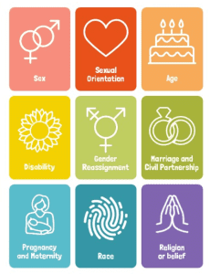

Slide 3
Key Changes
Greater clarity on sensitive and controversial topics- no age restrictions
Sex education is not compulsory-the DfE encourages schools to teach this in Years 5 & 6. Parents will be consulted- right to withdraw applies.
Reinforces safeguarding language and practise
Focus on prevention- a crucial tool for safeguarding
Greater focus on online safety and digital wellbeing
Focus on mental health and wellbeing including resilience and self-regulation
Schools may teach about faith perspectives-

Slide 4

Valuing All God’s Children
Guidance from the Church of England aimed at helping schools tackle homophobic, biphobic, and transphobic bullying,
ensuring all students feel safe and loved. It promotes an inclusive ethos where all pupils are respected, regardless of
sexual orientation or gender identity, often in conjunction with RSHE.
Key Aspects of "Valuing All God's Children":
Inclusive Vision: Schools are urged to create a culture of "informed vigilance" where every child is seen as cherished by God, creating a safe and welcoming environment.
Preventing Bullying: The guidance provides practical advice on recognizing and tackling HBT (homophobic, biphobic, and transphobic) bullying.
Curriculum: It encourages integrating education about different types of families and identities into the curriculum to promote understanding, rather than treating them separately.
Staff Training: It emphasizes training all staff (teaching and non-teaching) to understand and combat bullying.

Slide 5
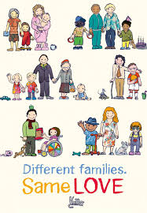
Key topic changes- Families
The importance of families- diversity
Addition of civil partnerships as a lifelong commitment
which is legally recognised, alongside marriage
Qualities of a friendship and how to manage conflict appropriately
Moves away from permission seeking
Setting and respecting boundaries for one another
Additional online safety content- including age restrictions for online which is currently set at age 13
Sharing images online and the associated risks
Importance of privacy and location settings
Learning about boundaries and learning via play

Slide 6

Key changes-General Wellbeing replaces Mental Wellbeing
Self-care
Isolation and loneliness
Loss and bereavement

Slide 7
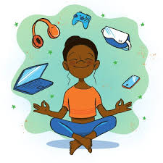
Key Changes- Wellbeing online replaces internet safety and harm
Positive and negative aspects of the online world
How to monitor time spent online
Taking a critical approach to what they see and read online
How to make responsible decisions about which content is appropriate for them
Abuse, bullying and harassment can occur online

Slide 8
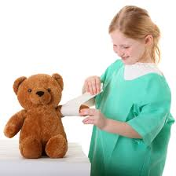
Additional Information
Basic first aid, healthy eating and physical health and fitness continue
to promote good choices
Drugs, alcohol and tobacco now includes vaping
Developing bodies- ensures children use the correct names for body parts
Helps pupils understand these body parts are private and it enables pupils to understand and express their own boundaries
Learn about facts about the menstrual cycle including physical and emotional changes- this can begin from Year 4

Slide 9
The process of withdrawal
Sex education- parents have the right to withdraw their child from content that is not covered within the Science Curriculum
Included in the Science Curriculum-Covers the naming of body parts, the human life cycle, reproduction in some plants and animals, and changes in the body from birth to old age (puberty).
RSHE content may include sensitive topics that cannot be opted out of

Slide 10
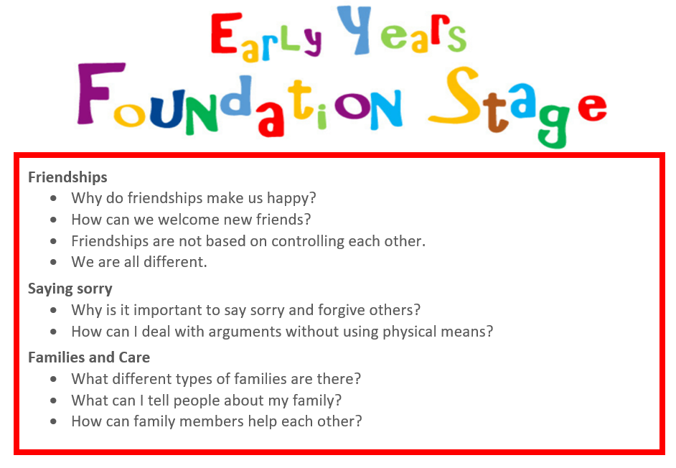

Slide 11
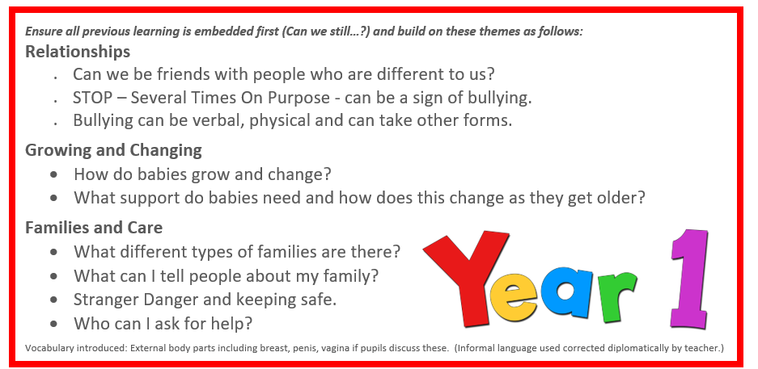

Slide 12
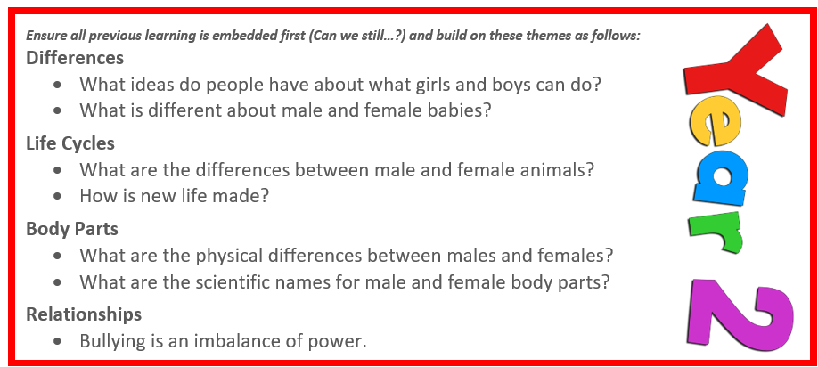

Slide 13
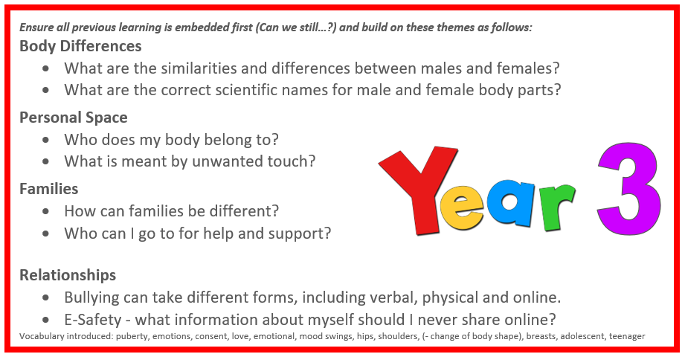

Slide 14
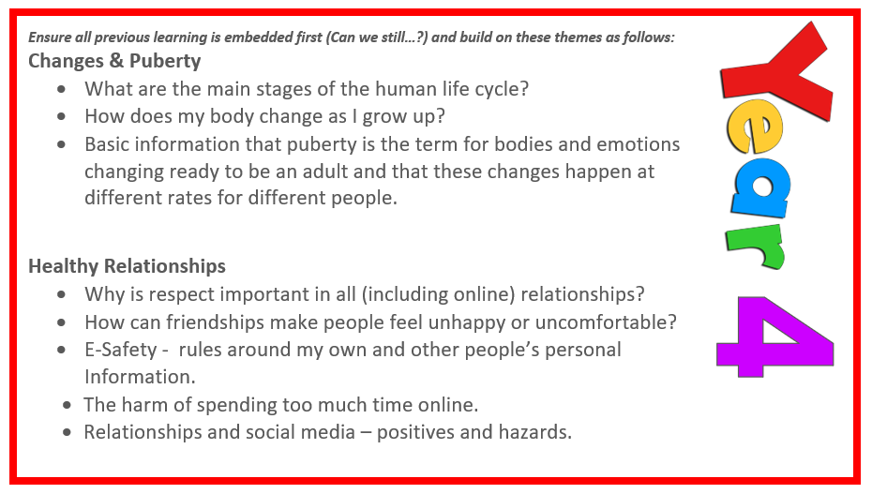

Slide 15
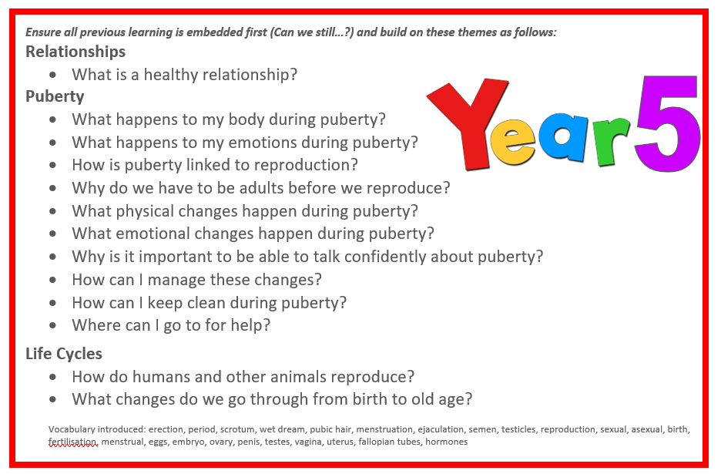

Slide 16
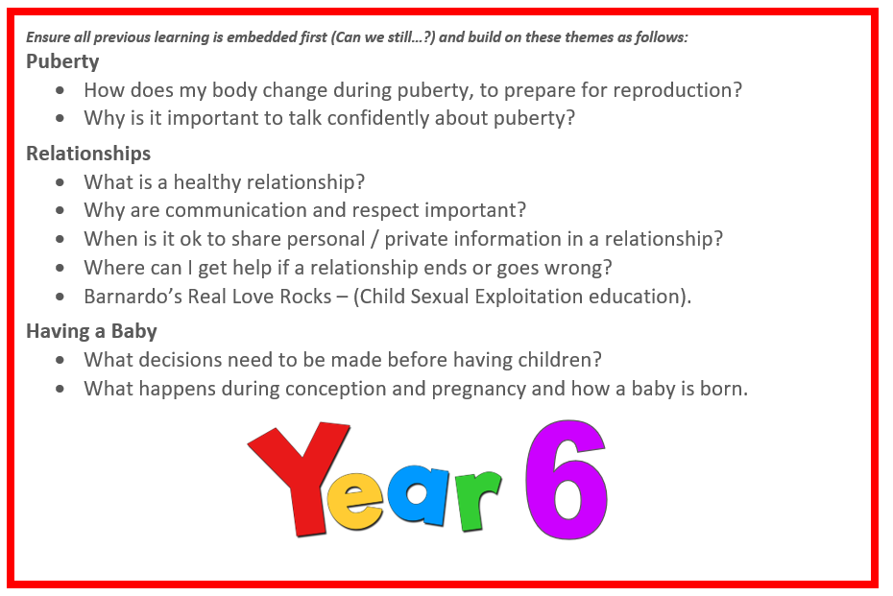

Slide 17

Equality, Diversity & PSHE at Travis St Lawrence CE Primary School
At Travis St Lawrence CE Primary School, we believe everyone should feel valued, included and able to thrive. Equality of opportunity is modelled by staff and taught through our curriculum, assemblies and daily interactions—both explicitly in lessons and discretely through our ethos and routines. Much of this learning sits within PSHE.
We follow the whole‑school My Happy Mind+ PSHE programme and enrich it with No Outsiders, giving pupils the knowledge, language and confidence to understand difference and stand up for fairness.
Our Curriculum: My Happy Mind+ PSHE + No Outsiders
My Happy Mind+ PSHE provides a spiral, age‑appropriate curriculum for Early Years to Year 6 that brings together PSHE, Relationships and Health Education, emotional literacy, mindfulness and social skills. It is designed to support statutory requirements and help children develop as confident, compassionate learners.
No Outsiders, created by Andrew Moffat MBE (a 2019 Global Teacher Prize finalist), uses carefully chosen picture books and discussion to promote inclusion and prepare children for life in modern Britain. The approach centers on three core values:
Respect for diversity through education in schools
Commitment to community cohesion through understanding and acceptance of difference
Promotion of dialogue to counter fear and hate in society

Slide 18
What children learn
Through age‑appropriate stories and activities, pupils explore seven protected characteristics of the Equality Act 2010 – those most suited to primary‑age learning: age, disability, gender reassignment, race, religion or belief, sex, and sexual orientation. (The Act defines nine characteristics in total; content is selected to be appropriate to age and context.)
Across the year, children:
learn the language of respect and inclusion and how to challenge prejudice kindly;
build empathy by seeing the world from different perspectives;
practise speaking up, listening well and disagreeing well;
connect learning to our school values, British Values and everyday choices.
The culture we’re building—together
We aim to foster a whole‑school culture where everyone belongs. This is reinforced through our SMSC, assemblies, class charters and pupil leadership. Children are supported to discuss inappropriate or discriminatory language, understand boundaries, and know how to seek help—essential preparation for life in modern Britain.
Our consistent messages:
There are no outsiders here.
Everyone is different—and we like being different.
We are all equal in our difference.
I can get along with you even if we are different.
British Values and the law protect everyone.

Slide 19
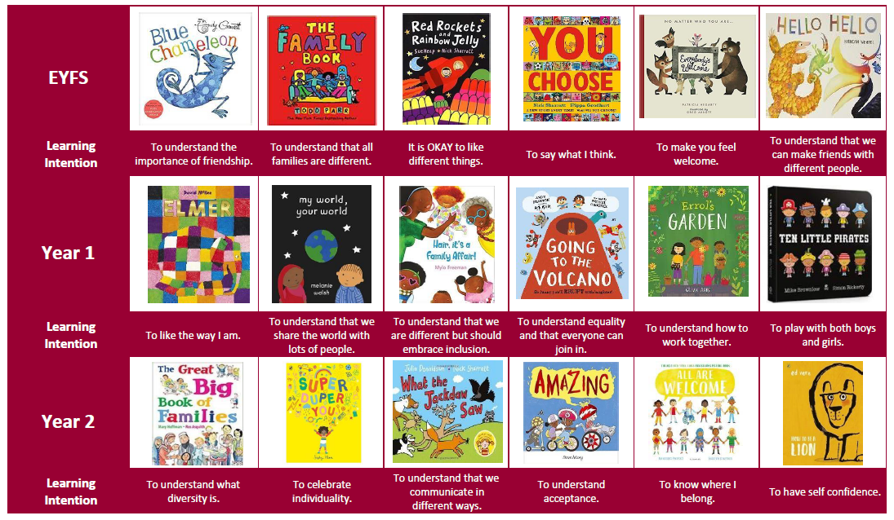

Slide 20
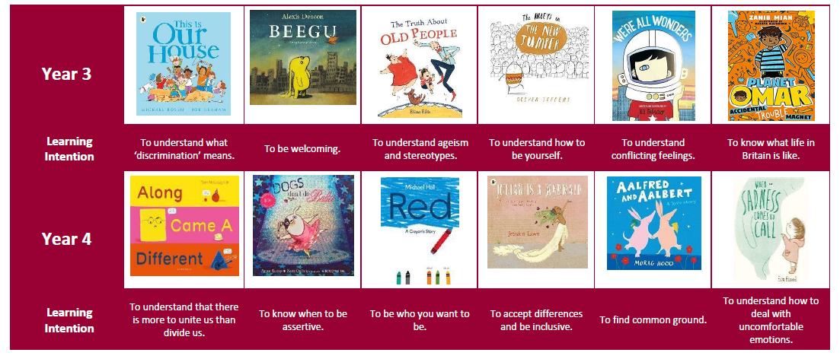

Slide 21
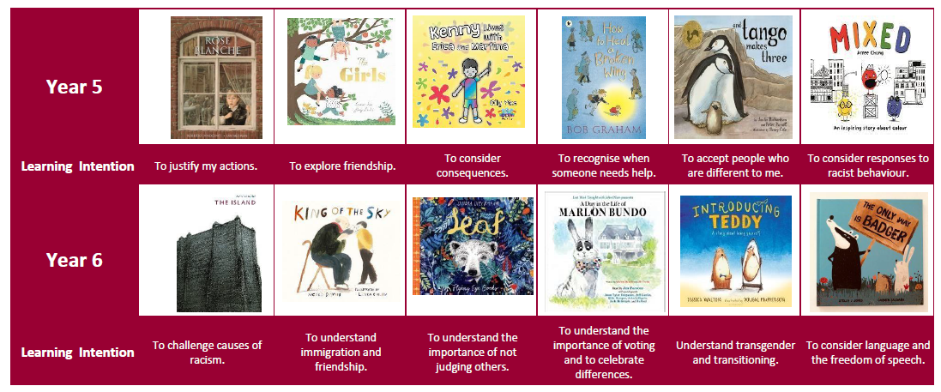

Slide 22
We thank you for taking the time to attend and treating this with the sensitivity that it deserves.
Please do ask any questions.

